Slide 1
European Days for Vocal and Choral Leaders An Event of the European Choral Association Utrecht, the Netherlands, 27 – 31 July 2022

Slide 2
WHY THIS EVENT? > no European meeting point > success of the conductors & composers programme in the EUROPA CANTAT festival since 2009 > research, wish from the network

Slide 3
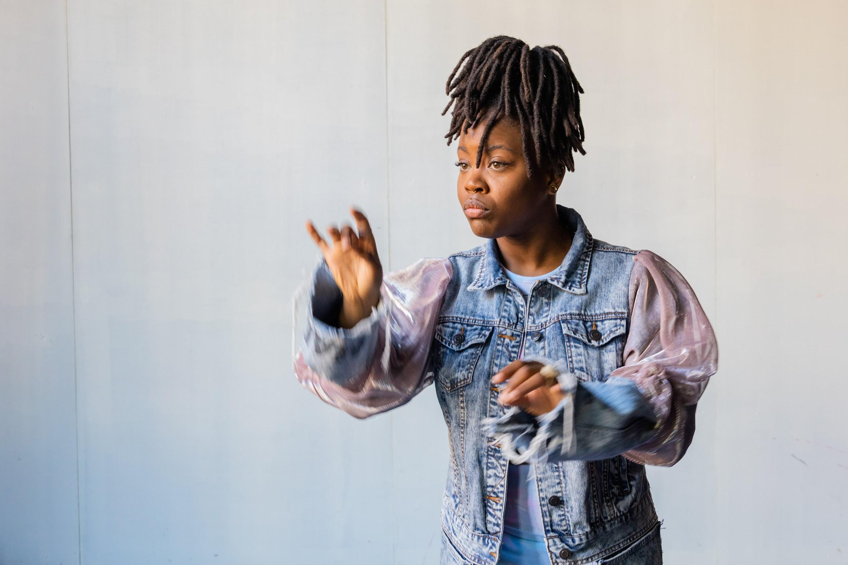
FOR WHOM IS THIS EVENT? > conductors & vocal leaders > music teachers & vocal coaches
> composers & creators > managers & artistic leaders > students in the above fields

Slide 4
MUSIC COMMISSION Burak Onur Erdem (TR) | Chair Martin Wildhaber (CH) Merel Martens (NL) Yuval Weinberg (DE) Seán Doherty (IR) Elisenda Carrasco (ES) Laura Lopes (PT) Panda van Proosdij (NL)

Slide 5
Explore the future of collective singing > Necessity & urgency even more clear now
> New ways of working > New challenges
> New landscape > New ways to connect > New tools
> New ideas concerning travel & meeting

Slide 6
What to expect? > 5 days > a European meeting point – also digital > exchange, network, scores, platform > concerts, workshops, experiments > parts accessible online

Slide 7
5 THEMES > develop your artistic skills > unleash your potential as a teacher > learn new management tricks > discover your inner leader > connect your work to society

Slide 8
5 FORMATS LEARN - workshops, masterclasses, lectures, showcases
LAB - co-creation and experiment
LETS MEET - planned lounges, meetings, round tables
LIVE - concerts
LITERATURE - marketplace and platform

Slide 9
UTRECHT (NL) > medieval city centre
> state of the art concert hall with 5 venues > over 100 churches > 350.000 inhabitants, 300 amateur choirs
> home of Netherlands Chamber Choir
> home of Dekoor Close Harmony > birth town of Miffy (including Miffy Museum)
> 30 min. by train from Schiphol Airport

Slide 10
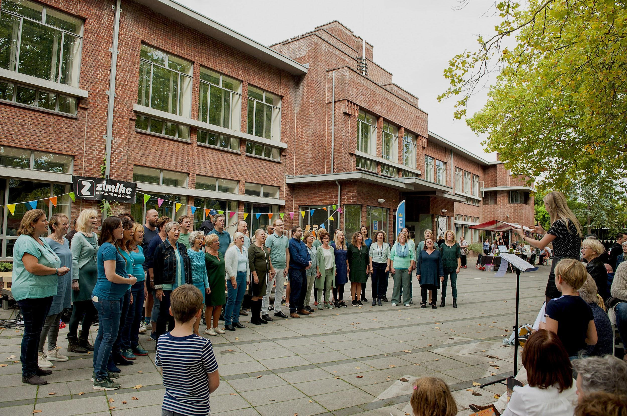
side programme: Utrecht Zingt festival > workshops for amateur singers
> low key choir to choir concerts in afternoons > open singings
> tickets sold separately

Slide 11
Tickets > sale from December 2021 > discount for indirect members of ECA > special price for students > one-day-only ticket available > all concerts and sessions included
Stay > special hotel offer available from December 2021 > meals not offered Programme > preview from July 15th on www.leadingvoices.nl > final programme presented in December 2021 Stay tuned > subscribe to our mailinglist

Slide 12
www.leadingvoices.nl
Utrecht, the Netherlands, 27 – 31 July 2022

